Slide 1
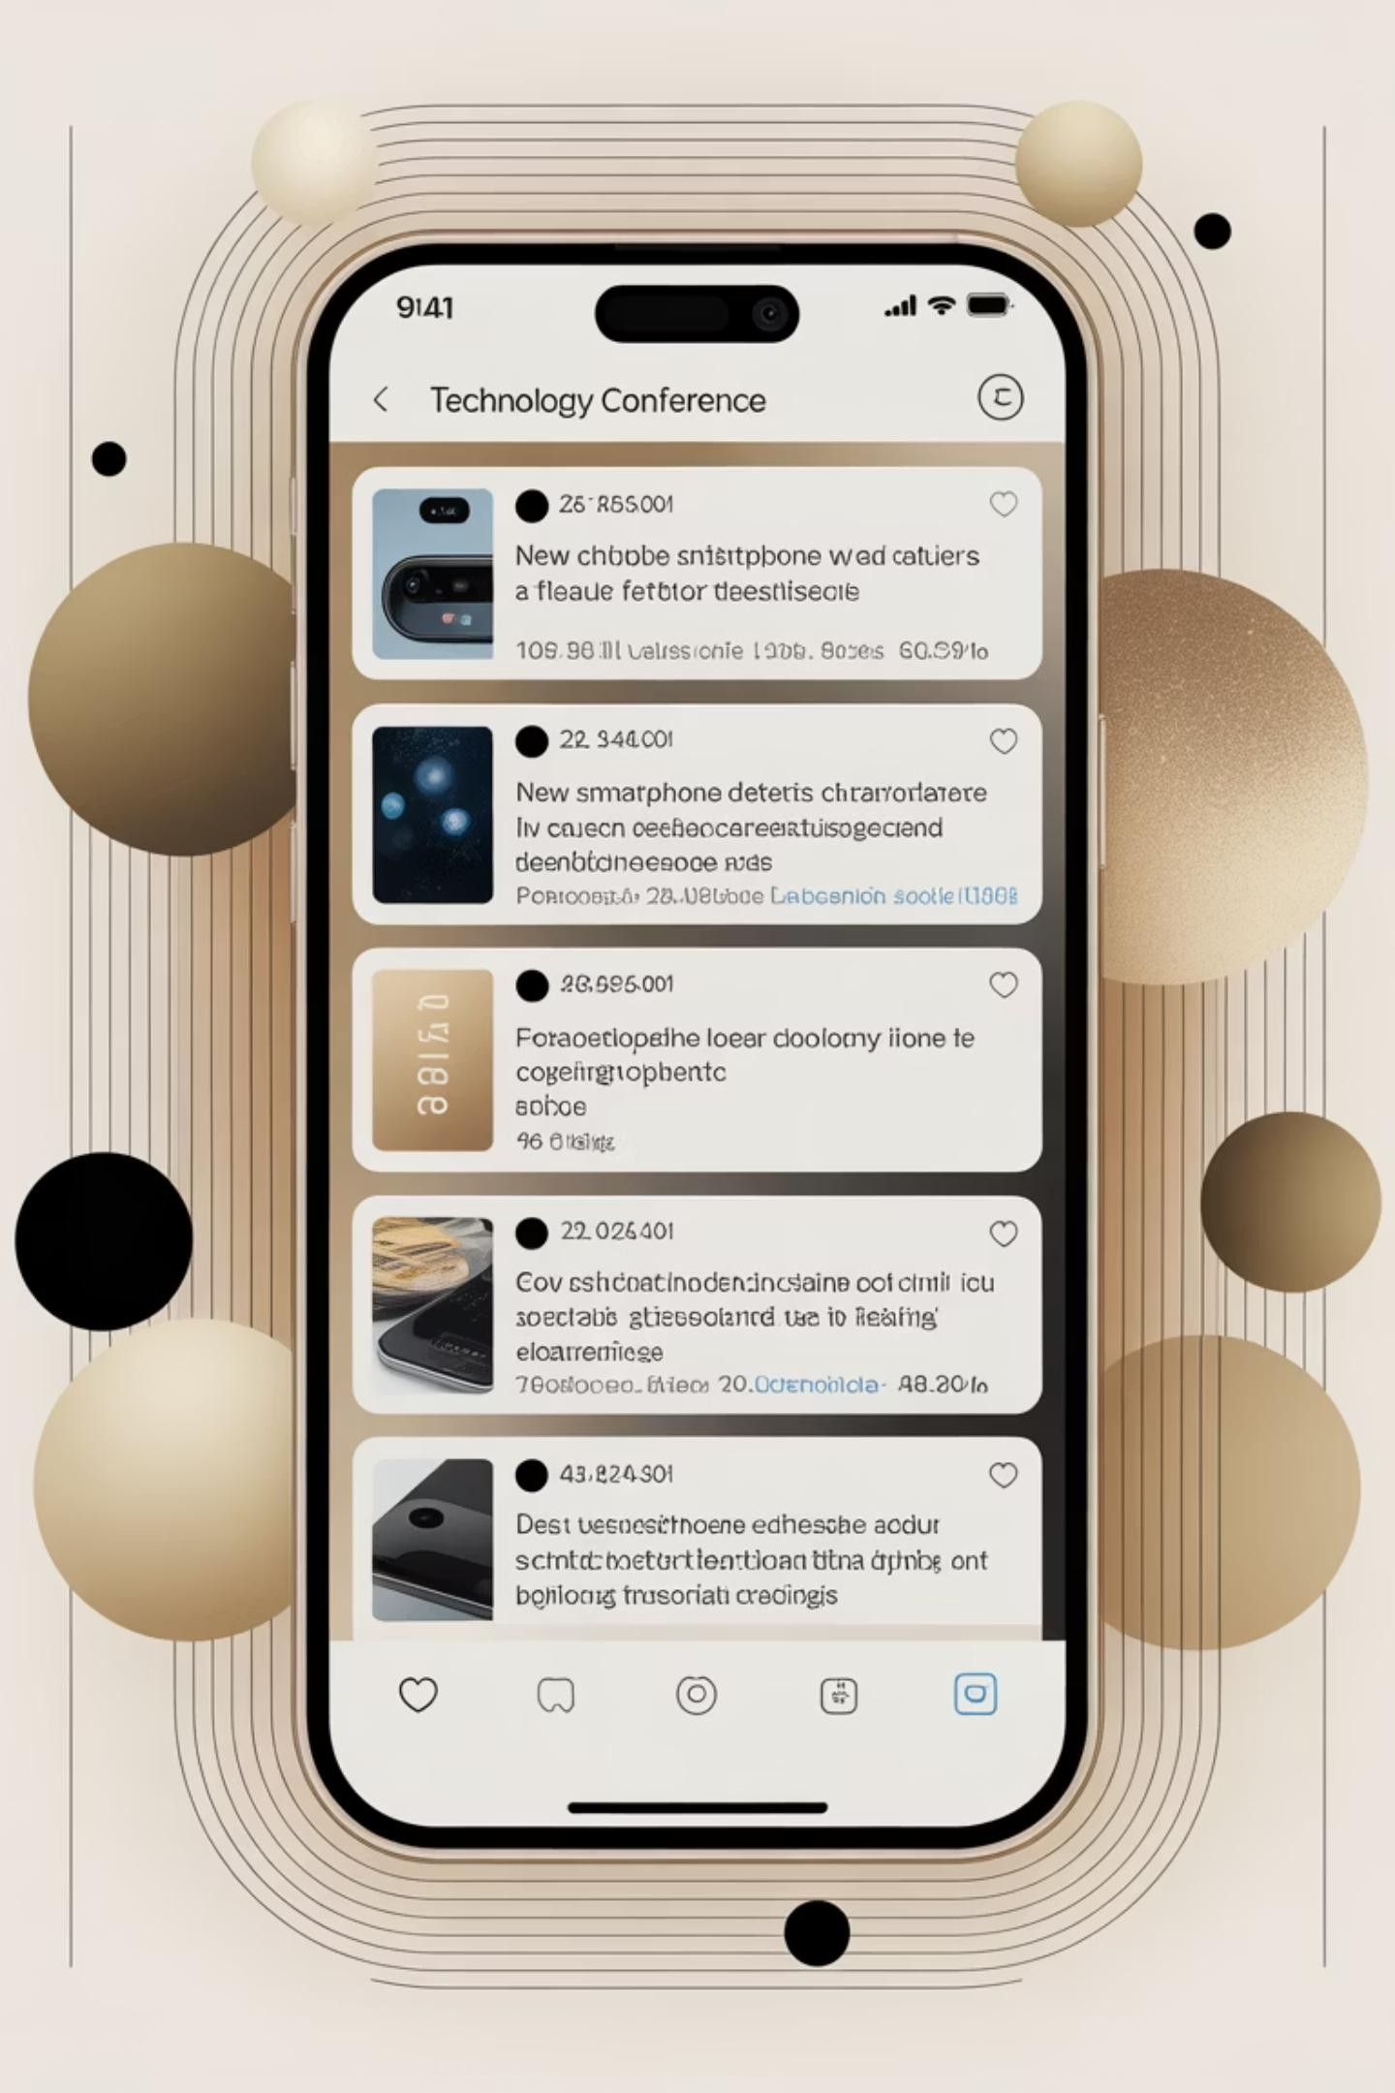
Sentiment Analysis of SXSW Tech Tweets
Natural Language Processing & Machine Learning Project
By: Lilibeth Langat Jeniffer Mbugua Lydia Khisa Vicky Gakuo Kefa Mwai

Slide 2



Introduction: The Power of Sentiment Analysis
Unstructured Text Challenge
Social media platforms generate massive volumes of unstructured text daily, creating opportunities for automated analysis
Public Opinion Insights
Sentiment analysis enables organizations to understand public opinion, track brand perception, and identify emerging trends in real-time
Automated Classification
Natural Language Processing and Machine Learning techniques automate sentiment classification, replacing manual annotation

Slide 3
Problem Statement
1
Manual Analysis Inefficiency
2
Noisy Data Challenge
Research Focus
Social media data contains emojis, hashtags, slang, and typos that complicate automated processing
Developing ML models to classify SXSW technology tweet sentiment accurately despite class imbalance
Manual sentiment analysis becomes impractical with thousands of tweets, requiring excessive time and resources
3
Need for Automation
Automated sentiment classification systems are essential for real-time analysis at scale

Slide 4
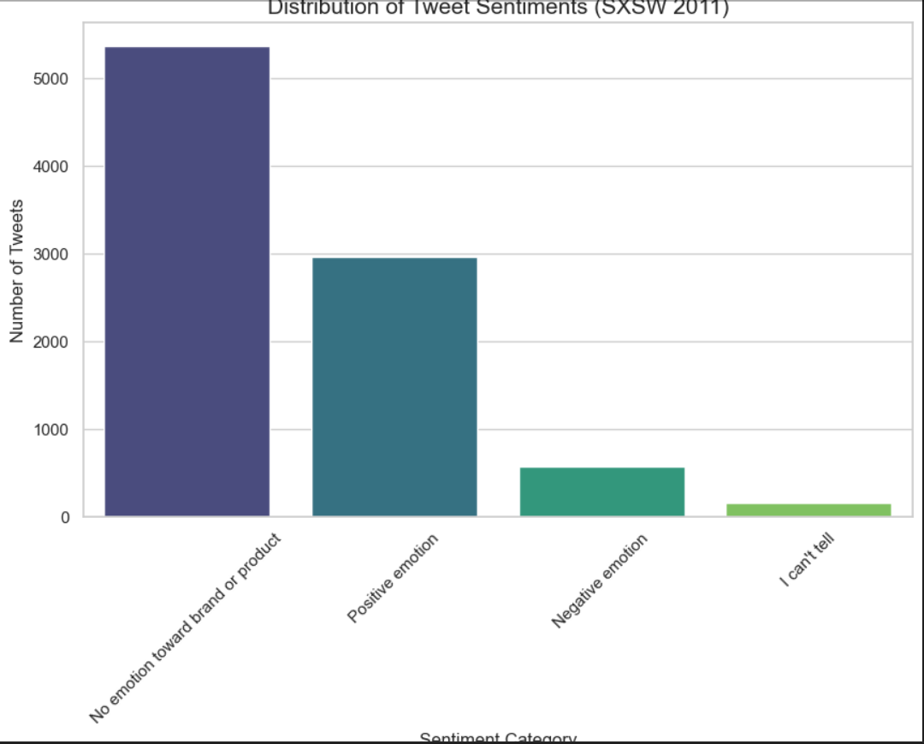
Dataset Overview
Source Data
Tweets mentioning technology products during SXSW conference events
Key Features
tweet_text: Full tweet content
product_target: Mentioned product
sentiment: Labeled sentiment
class
Sentiment Classes
Multiple sentiment categories: positive, negative, and neutral classifications
present

Slide 5
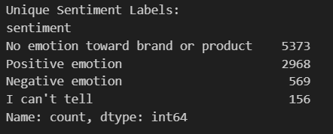
Exploratory Data Analysis
Key Findings
Sentiment Distribution
Analyzed frequency of each sentiment
class across the dataset
Class Imbalance
Identified significant imbalance among sentiment categories
Positive Dominance
Positive sentiment substantially outnumbers negative and neutral classes

Slide 6

Text Preprocessing Pipeline
Normalization
Convert all text to lowercase for consistency
Cleaning
Remove punctuation, numbers, and special characters
Stopword Removal
Filter out common words with minimal semantic value
Tokenization
Split text into individual words or tokens
Lemmatization
Reduce words to their base dictionary form

Slide 7
Feature Engineering: TF-IDF Vectorization
Methodology
Implementation
Term Frequency-Inverse Document
Frequency technique
Converts text documents into numerical feature vectors
Weights terms by importance in document vs. corpus
Higher scores for terms frequent in document but rare overall
Preserves semantic meaning through
weighted representation
Text data transformed into high- dimensional numerical vectors suitable for ML algorithms while maintaining word importance signals

Slide 8
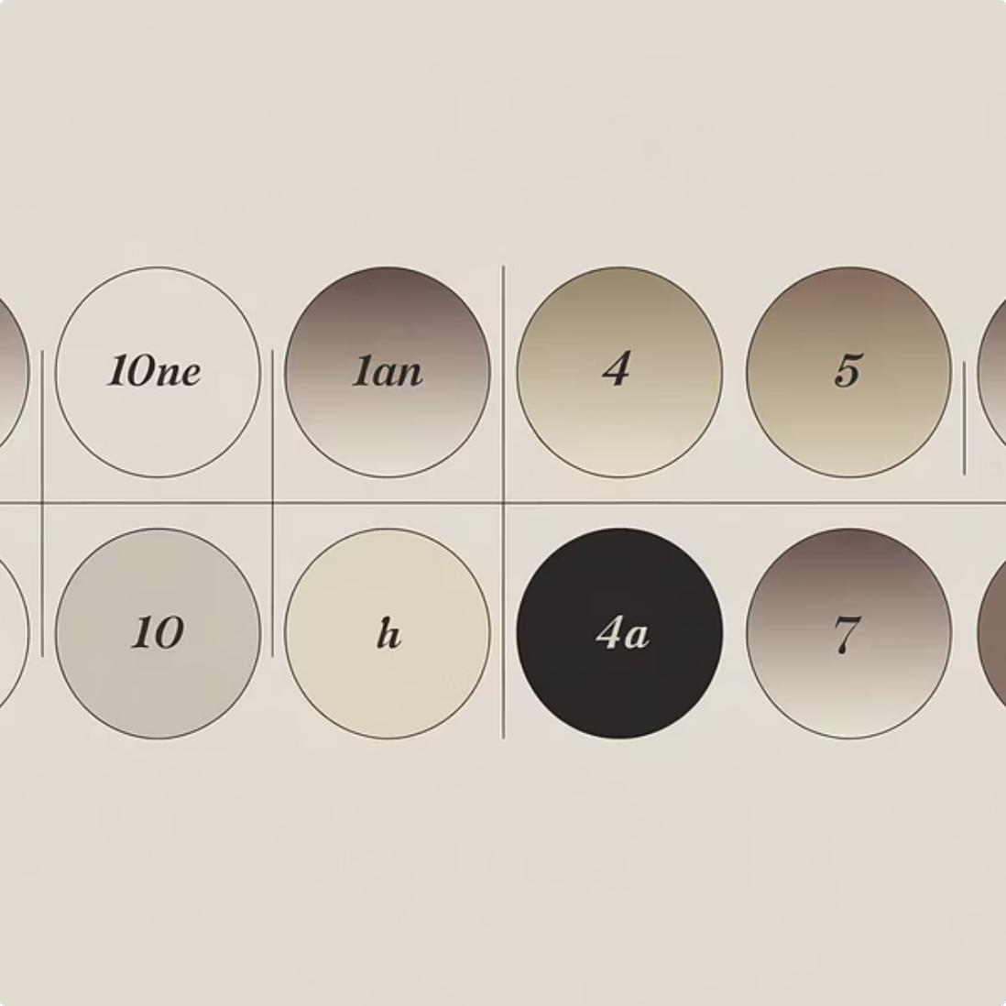


Machine Learning Models
Multinomial Naive Bayes
Baseline probabilistic classifier using Bayes' theorem with frequency-based features
Random Forest
Ensemble method combining multiple decision trees for improved accuracy and robustness
XGBoost
Gradient boosting framework with optimized tree-based models for enhanced performance

Slide 9
Model Training and Evaluation
01
02
03
Data Splitting
Divided dataset into training and testing sets for model validation
Hyperparameter Tuning
Applied GridSearchCV to optimize model parameters systematically
Performance Metrics
Evaluated using precision, recall, and F1-score across all sentiment classes
04
05
Confusion Matrix
Analyzed classification errors and misclassification patterns
Class Imbalance
Accounted for uneven class distribution during evaluation

Slide 10
Results and Future Directions
Key Findings
Best Model
Random Forest achieved highest overall performance across evaluation metrics
Ensemble Success
Tree-based ensemble methods outperformed baseline Naive Bayes classifier
Challenge Area
Negative sentiment prediction proved most difficult due to class imbalance
Future Work
Data Balancing
Apply oversampling or undersampling techniques to address class
imbalance
Deep Learning
Explore neural network architectures like LSTM or BERT for
enhanced performance

